Slide 1
Ai.rty
Be your own fashion
designer!

Slide 2
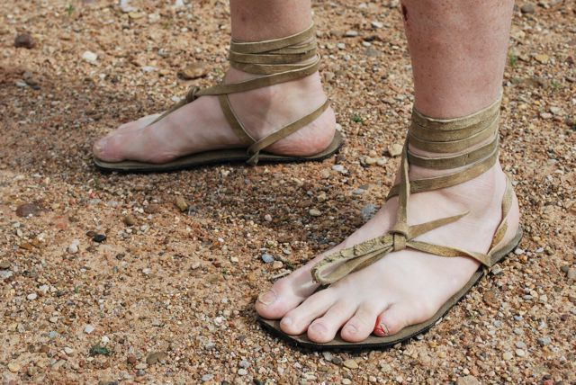
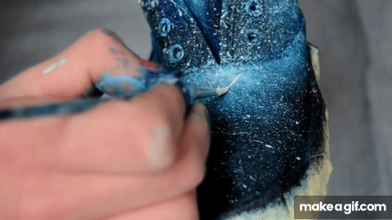
Prehistoric times
You or relative makes your shoes
Customizable to a small extent
Recently
Hard work for DIY customization

Slide 3
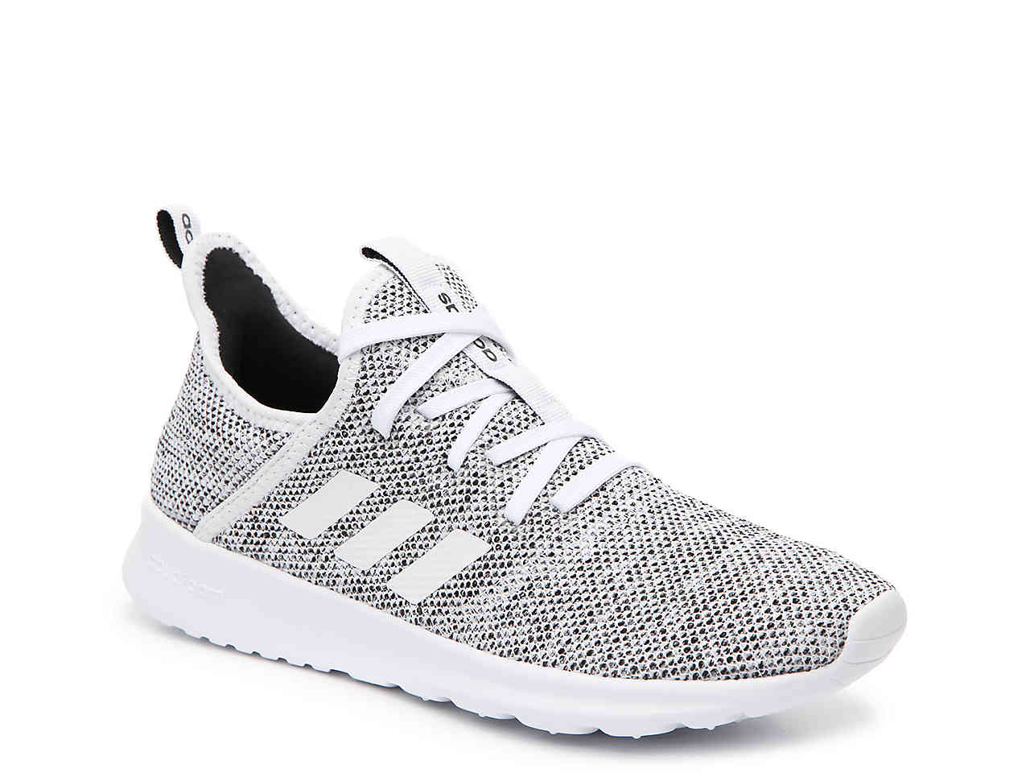
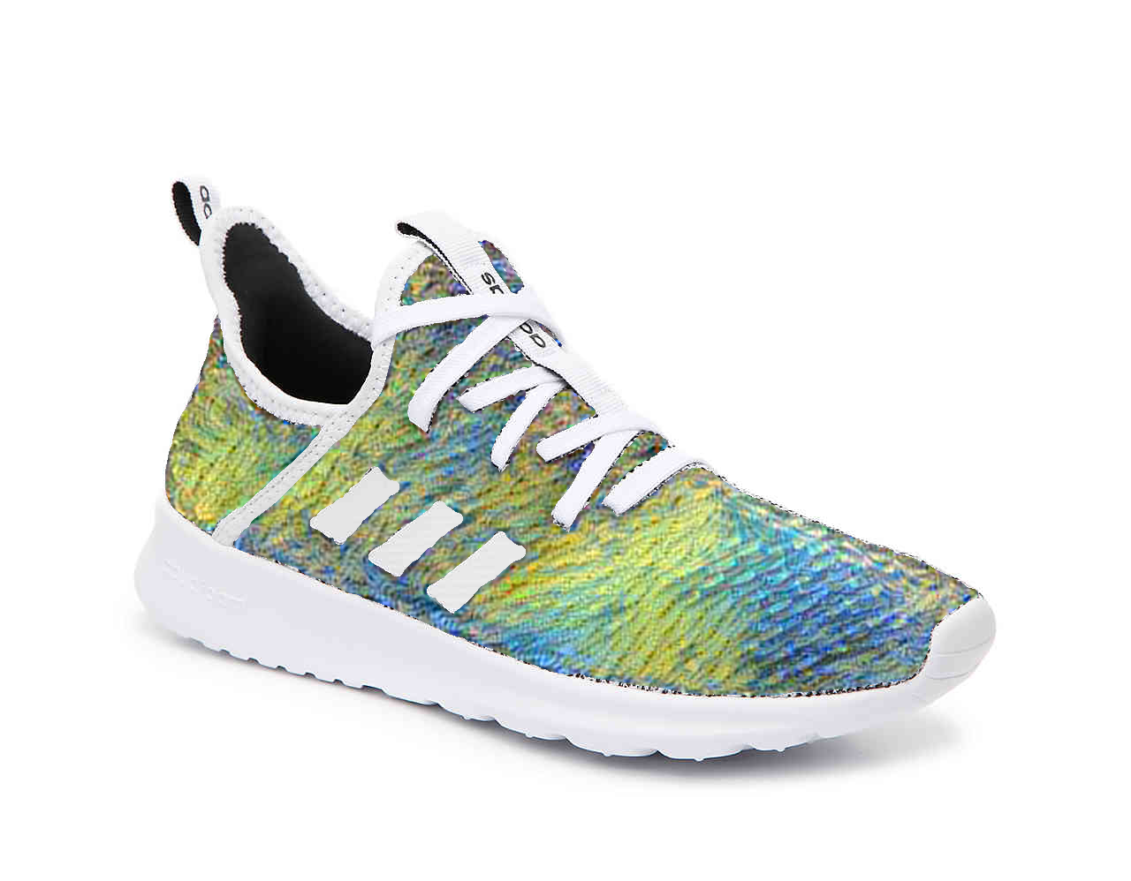
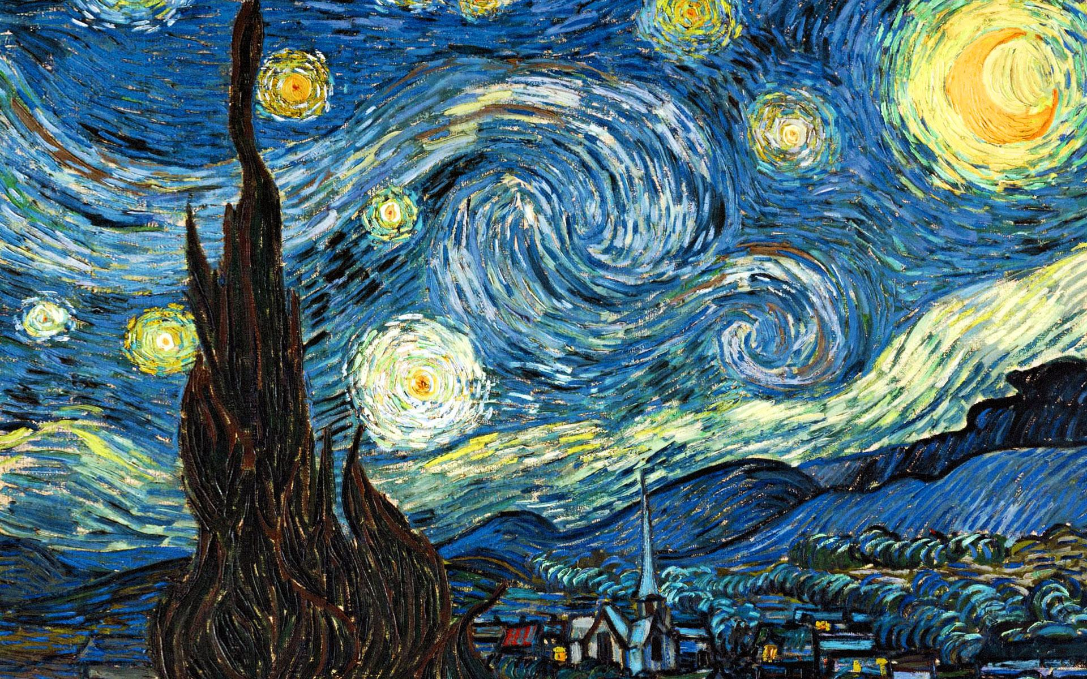
Renaissance
+
=

Slide 4
Demo ⇝

Slide 5

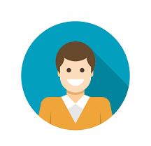
Stakeholders
Increases app time usage of customers
Personalized shopping experience
Makes clever use of latest 3D-printing technologies
First-to-market
Possessing unique Adidas products
Broadens customer segment
People willingly share their custom adidas products on social media

Slide 6





Technology Stack

Slide 7
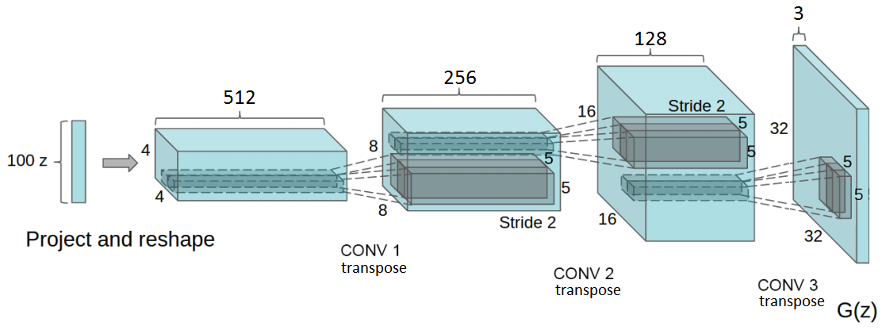
The Brain (i.e. DCGAN)

Slide 8
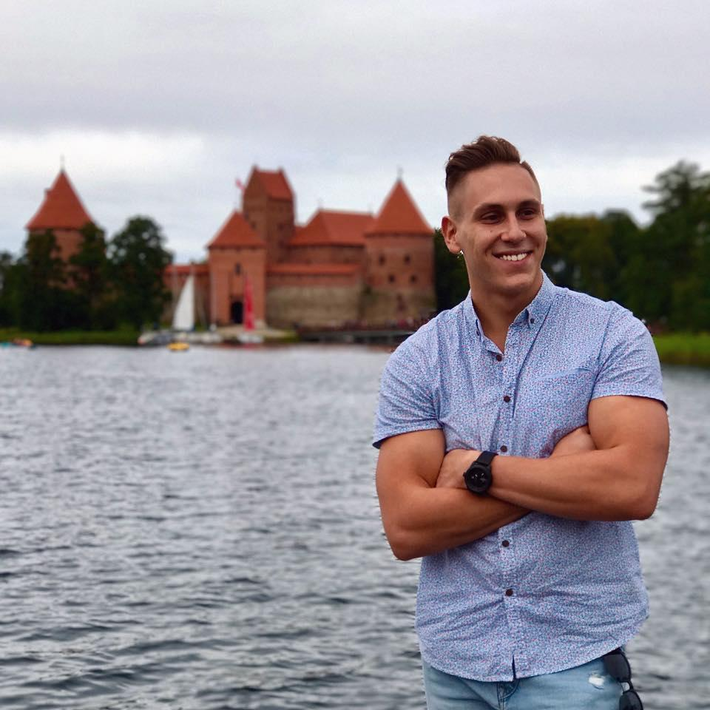
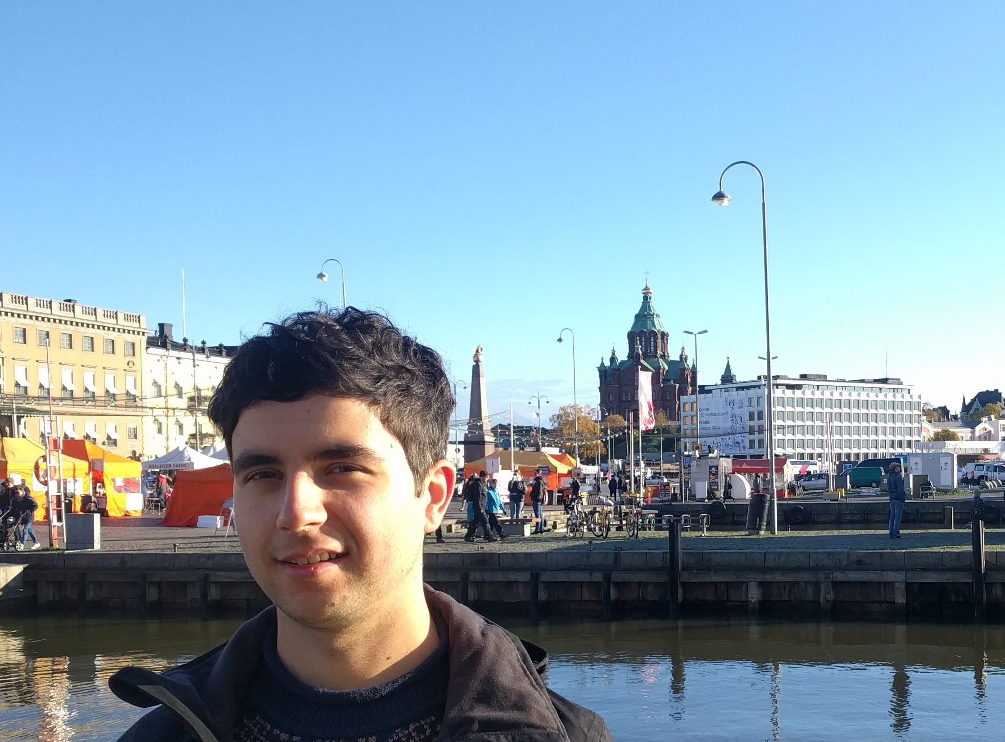
The team
Tomas Šostak
Nicolae Righeriu
Tomas Komar
Jeroen Brouns
Suraj Iyer

Slide 9
Thank You for
Your attention!
Q & A time!
Ai.rty

